Slide 1
MODULE II: HARDWARE BASICS

Slide 2
Lesson 1: Computer Peripherals

Slide 3
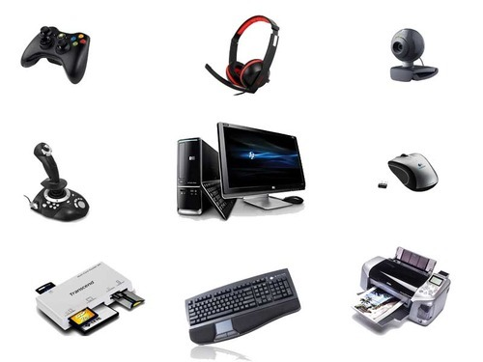
DEFINITION
Peripherals are devices that are connected to a computer but are not part of the computer architecture. These are:
Input devices : interact with, or send data to the computer
Output devices :Provides output to the users from the computer
Storage devices : Store data processed by the computer

Slide 4
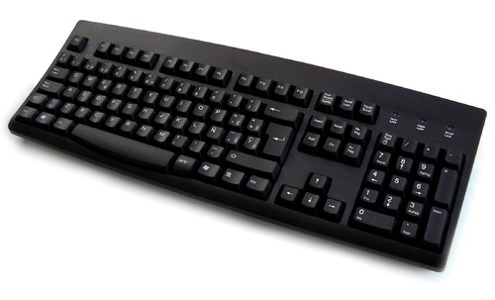
INPUT DEVICES
1. Keyboard
A computer keyboard is an input device used to enter characters and functions into the computer system by pressing buttons, or keys.

Slide 5
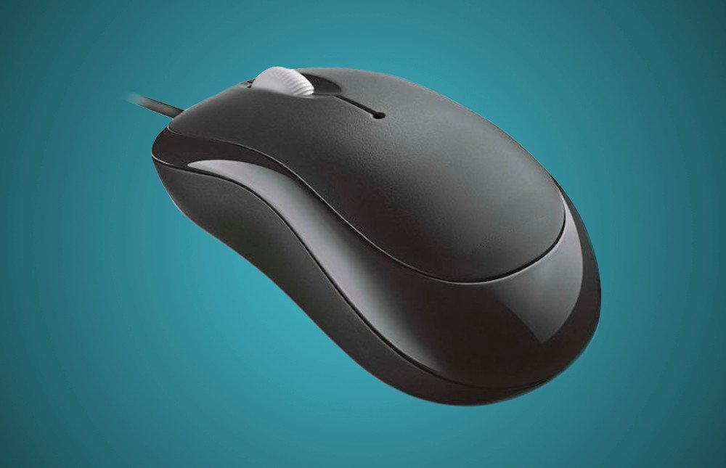
Cont…
2. Mouse
A mouse is a device that controls the movement of the cursor or pointer on a display screen.

Slide 6
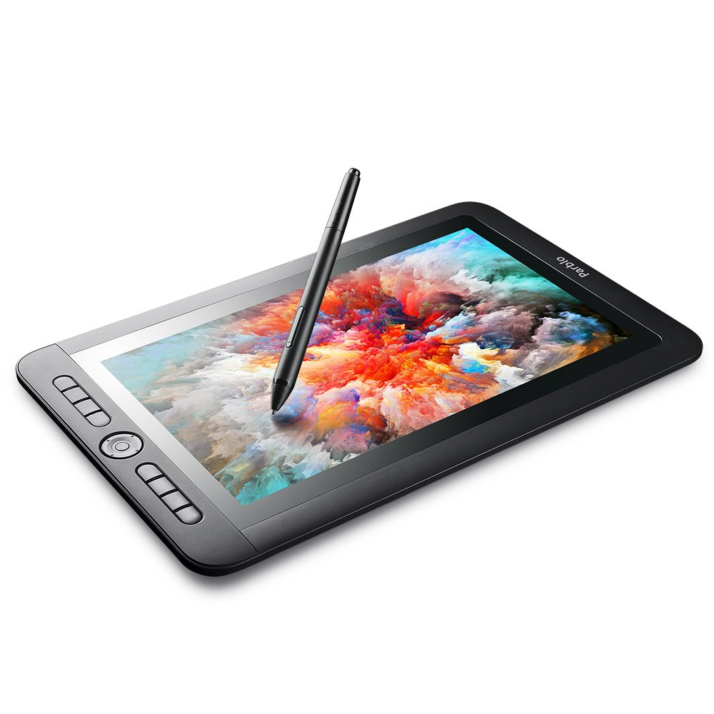
Cont…
3. Graphic Tablet
A graphics tablet is a computer input device that enables a user to hand-draw images, animations and graphics, with a special pen-like stylus, similar to the way a person draws images with a pencil .

Slide 7
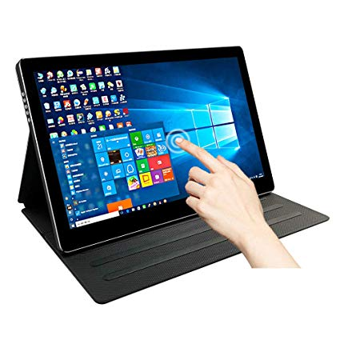
Cont…
4. Touch Screen
A touch screen is a computer display screen that serves as an input device. When a touch screen is touched by a finger or stylus, it registers the event and sends it to a controller for processing.

Slide 8
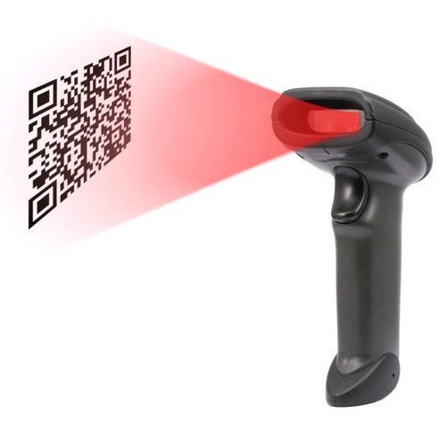
Cont…
5. Barcode reader
A barcode reader, also called a price scanner or point-of-sale ( POS ) scanner, is a hand-held or stationary input device used to capture and read information contained in a bar code.

Slide 9
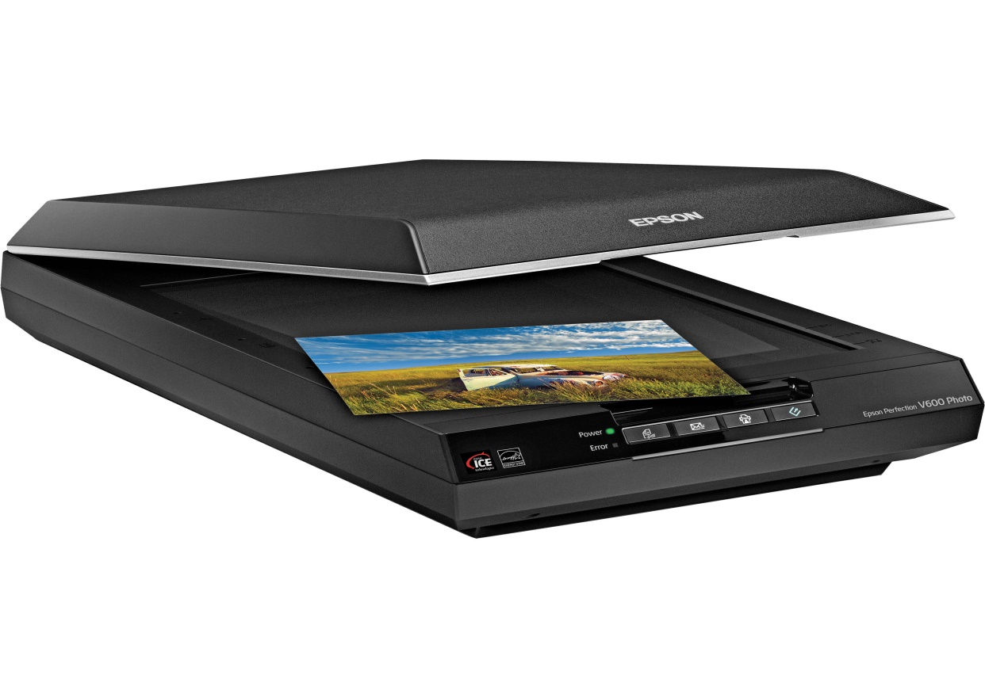
Cont…
6. Image Scanner
This is a hardware input device that optically "reads" an image and converts it into a digital signal.

Slide 10
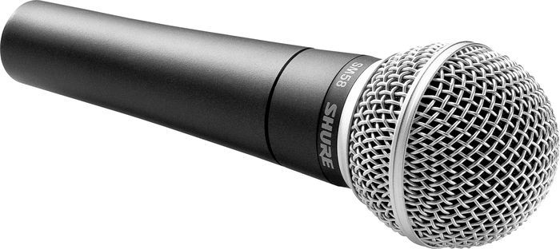
Cont…
7. Microphone
A microphone is a device that captures audio by converting sound waves into an electrical signal. This signal can be amplified as an analog signal or may be converted to a digital signal, which can be processed by a computer or other digital audio device.

Slide 11
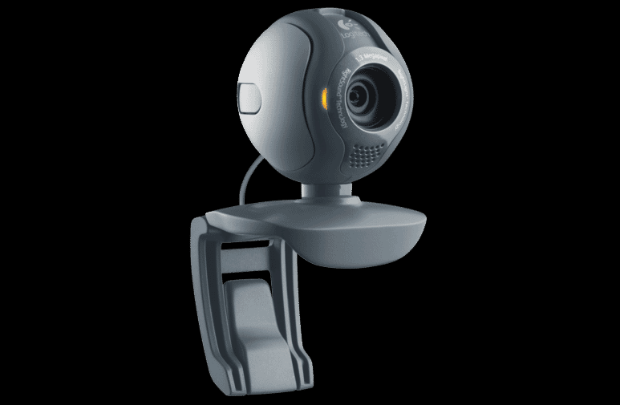
Cont…
7. Webcam
The term webcam is a combination of "Web" and "video camera." The purpose of a webcam is, not surprisingly, to broadcast video on the Web. Webcams are typically small cameras that either attach to a user's monitor or sit on a desk. They serve a variety of purposes, from taking still images to sending a live video over conference calls.

Slide 12
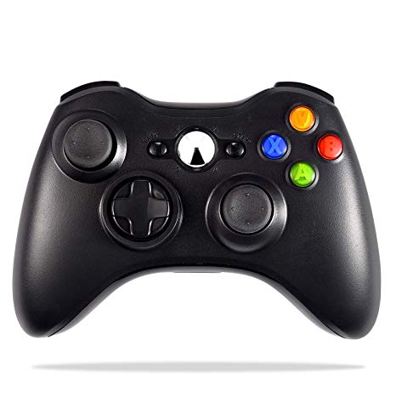
Cont…
8. Game Controller
A game controller, or simply controller, is an input device used with video games or entertainment systems to provide input to a video game, typically to control an object or character in the game.

Slide 13
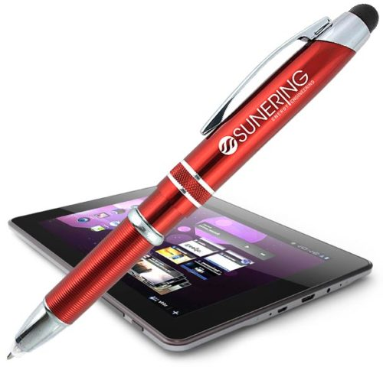
Cont…
8. Light pen
It is a pen shaped device used to select objects on a display screen.

Slide 14
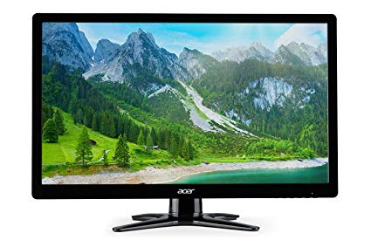
OUTPUT DEVICES
1. Computer Monitor
A computer monitor is an output device that displays information in pictorial form. A monitor usually comprises the display device, circuitry, casing, and power supply.

Slide 15
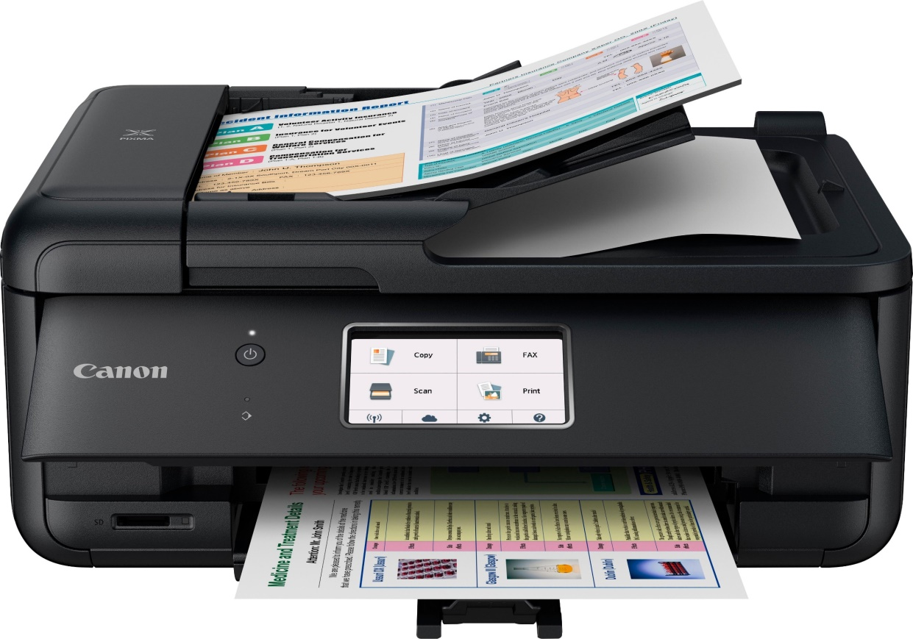
Cont…
2. Printer
Printers are a type of computer peripheral device that fall into two broad categories: 2D printers that print text and graphics onto paper (or other media) and 3D printers that create physical objects

Slide 16
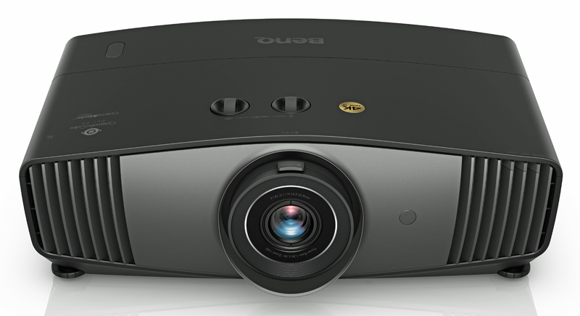
Cont…
3. Projector
A projector or image projector is an optical device that projects an image onto a surface, commonly a projection screen. Most projectors create an image by shining a light through a small transparent lens, but some newer types of projectors can project the image directly, by using lasers.

Slide 17
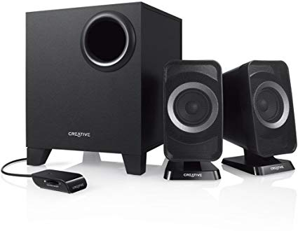
Cont…
4. Speaker
Speakers regardless of their design, the purpose of speakers is to produce audio output that can be heard by the listener.

Slide 18
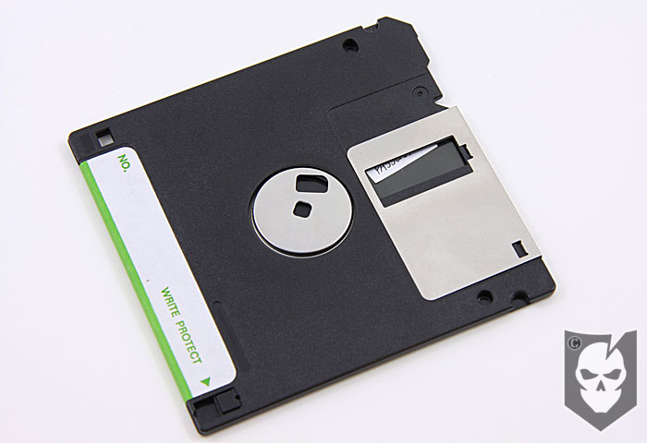
STORAGE DEVICES
1. Floppy disk drive
A floppy disk drive (FDD), or floppy drive, is a hardware device that reads data storage information. It was invented in 1967 by a team at IBM and was one of the first types of hardware storage that could read/write a portable device. FDDs are used for reading and writing on removable floppy discs.

Slide 19
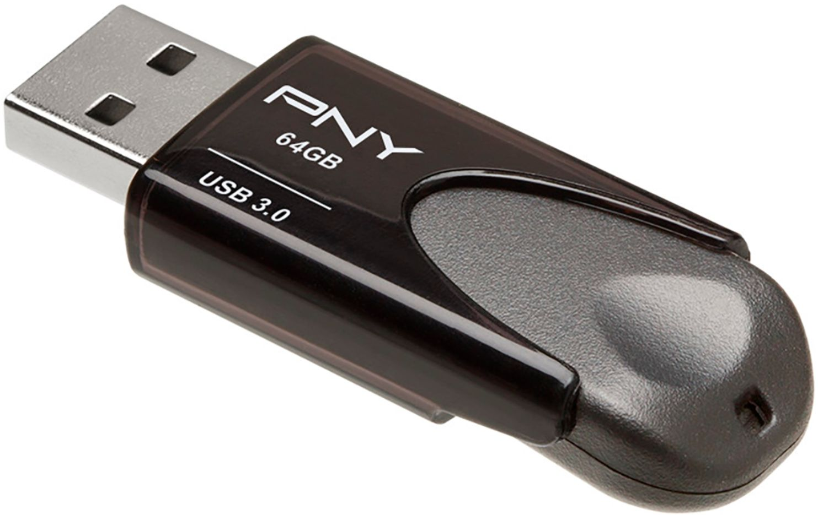
Cont…
2. USB Flash Drive
A USB flash drive is a data storage device that includes flash memory with an integrated USB interface.

Slide 20
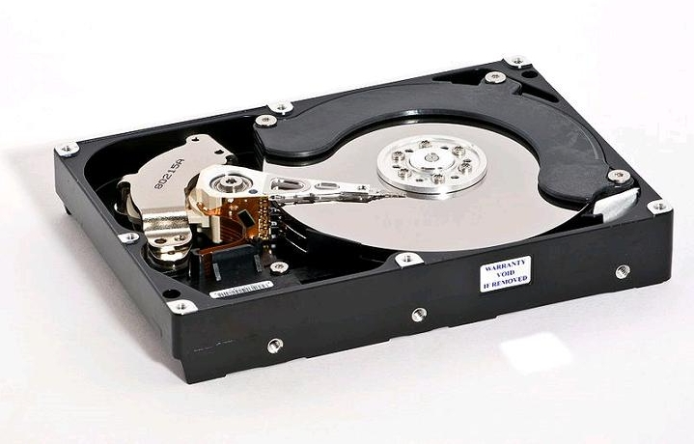
Cont…
3. Disk Drive
A disk drive is a randomly addressable and rewritable storage device. ... The operating system, software titles, and most other files are stored in the hard disk drive. The hard drive is sometimes referred to as the "C drive" due to the fact that Microsoft Windows, by default, designates the "C" drive letter to the primary partition on the primary hard drive in a computer.

Slide 21
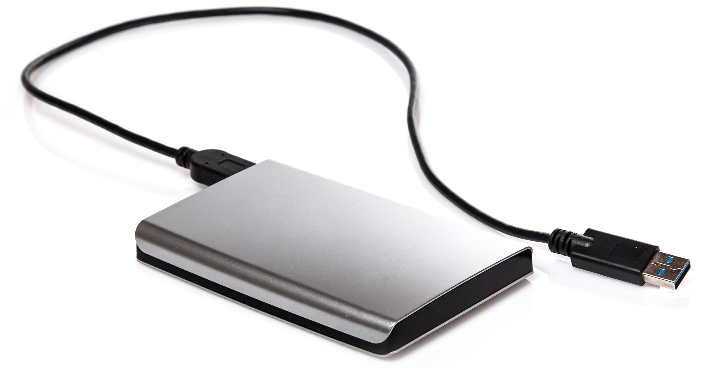
Cont…
4. External Hard Drive
An external hard drive is a portable storage device that can be attached to a computer through a USB or FireWire connection, or wirelessly. External hard drives typically have high storage capacities and are often used to back up computers or serve as a network drive.

Slide 22
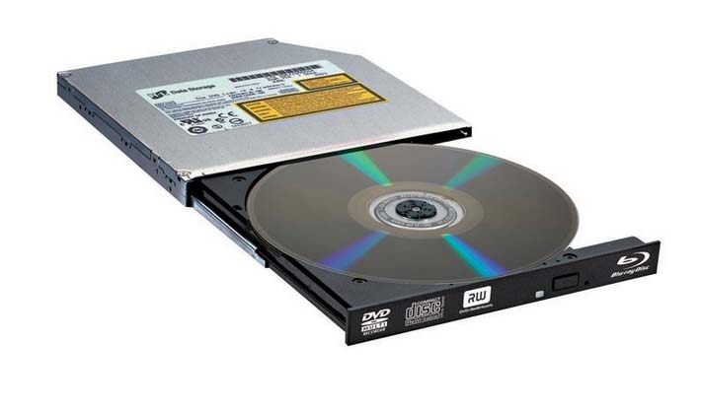
Cont…
5. CD/DVD Drive
An optical disc drive that reads and writes all common CD and DVD formats. All modern optical drives that come with personal computers are CD/DVD drives. See DVD writer, CD-ROM drives and DVD drives.

Slide 23
END

